Slide 1
Ms PacMan vs Ghost Team
17150694/1 WID170022

Slide 2
Algorithm used
Inspired using minimax method.

Slide 3
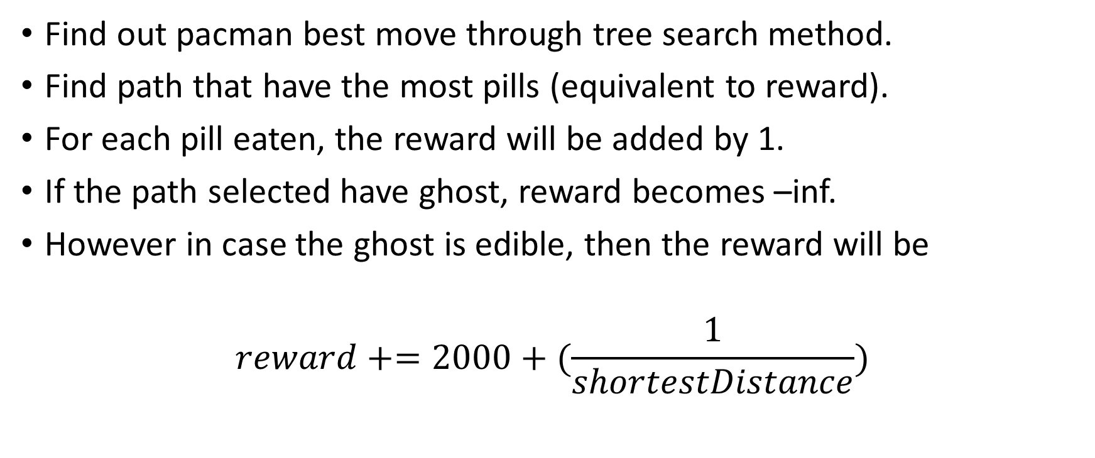
Pacman best move
Find out pacman best move through tree search method.
Find path that have the most pills (equivalent to reward).
For each pill eaten, the reward will be added by 1.
If the path selected have ghost, reward becomes –inf.
However in case the ghost is edible, then the reward will be
$$reward+=2000+(\frac{1}{shortestDistance})$$

Slide 4
Ghost Best Move
Ghost best move is always the shortest distance to reach pacman. (assumption)
If the path has pacman, then the reward will be inf.

Slide 5
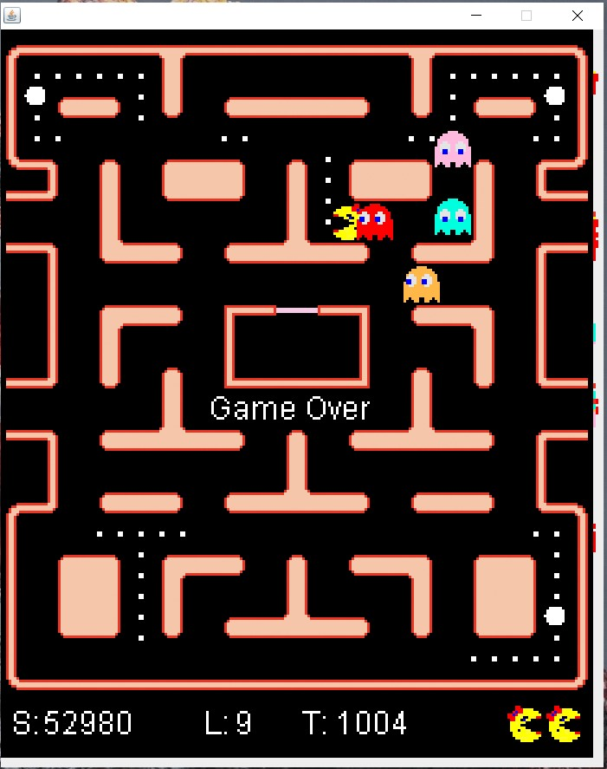
Best score

